Slide 1
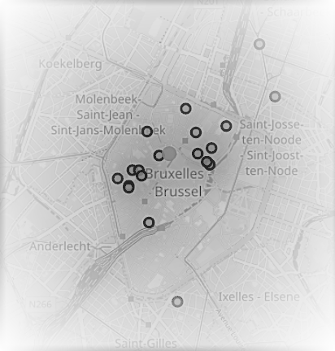
Open a new bar in Brussels center specific market approach missing gap: students

Slide 2
Nightlife of Brussels
The nightlife in the center is more focused on locals or tourists.
Nightlife for students out of the center:
Brussels is not a very safe or friendly environment for bikes and steps: altitude differences, bumpy road, traffic, …
significant amount of students feel unsafe to walk large distances at night or get in a cab with someone they don't know.
Using a private car is not a good alternative for most students and it is difficult to find parking spots.
public transportation stops around 01h00.

Slide 3
Students in Brussels
most students of Belgium
difficult for new students (Freshmen and international students) to make new friends
not visible in the center
there are a lot of dorms and schools

Slide 4
how much nightlife
in the center
around the dorms?
List of dorms with the amount of nightlife compared
Radius 200m, 150m, 100m and 50 m

Slide 5
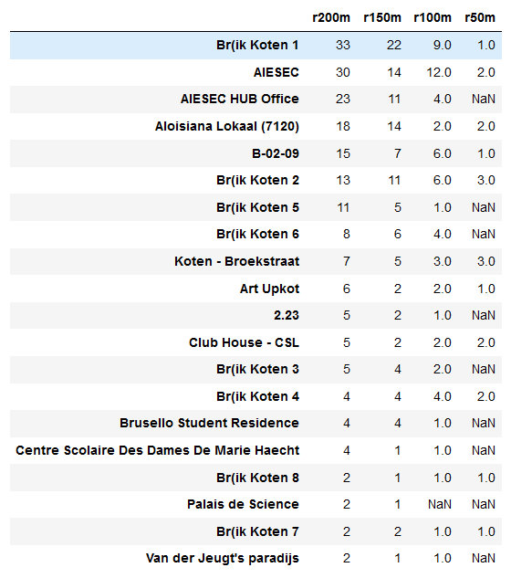

Slide 6
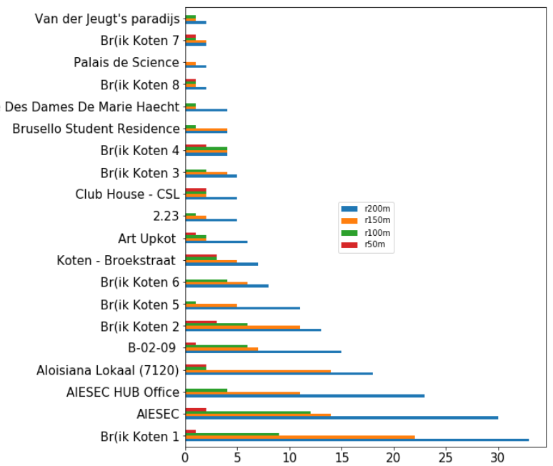
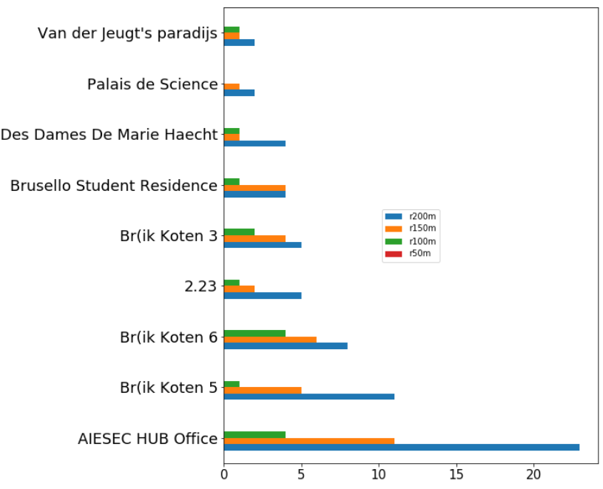
Not much nightlife around in total
No nightlife in radius of 50m

Slide 7
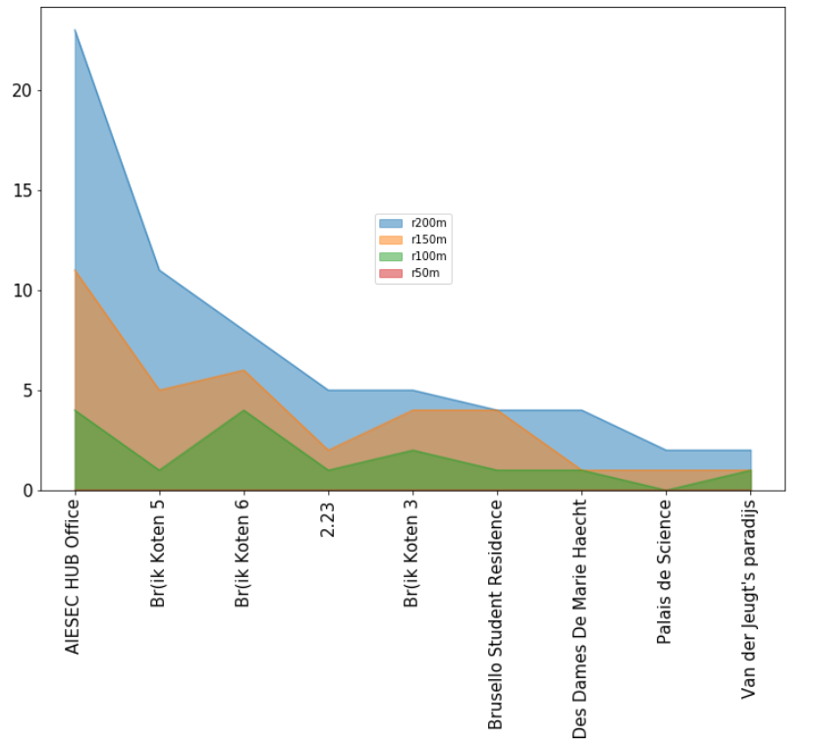
No nightlife in radius of 50m

